Slide 1
The Urge and Struggle to Establish Science Based
Swadeshi Industries
Created By
Dr. Himanki Dabral
Assistant Professor
Doon Business School, Dehradun
Uttarakhand, India
Edited By
Dr. Anu Singh
UGCWPDF
Jawaharlal Nehru University,
New Delhi-110067, India.
Courtesy: Samvet Bharat, Nathuwala, opposite Rajrajeshwari Mandir, Balawala Road, Dehradun- 248008

Slide 2
CONTENT
Introduction
Pre Colonial period
Colonial period
Swadeshi movement
Establishment of Science based Swadeshi Industries
Conclusion
References

Slide 3
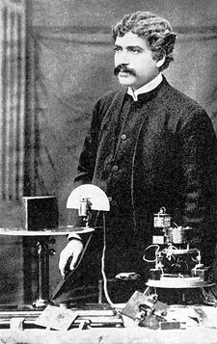
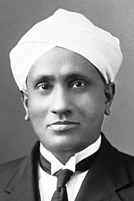
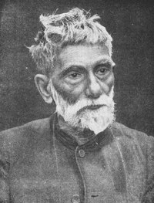
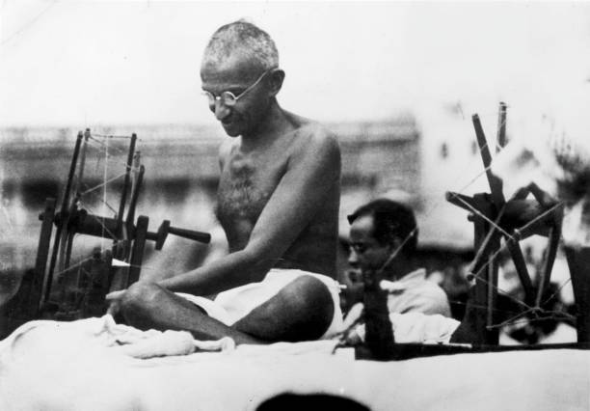
INTRODUCTION
The scientific capabilities of Indians were challenged during colonial period.
Rise of the spirit of “swa” and to become “self-reliant” in the field of science.
Swadeshi Movement of Bengal (1903-1908) was a major step of India’s freedom struggle against British colonial rule.
The pioneers of scientific industrialization in pre-independence India.
Jagadish Chandra Bose, Prafulla Chandra Ray, Chandrashekhara Venkat Raman and others.
Mahatma Gandhi in 1916 states swadeshi as the “spirit in us which restricts us to the use and services of our immediate, to the exclusion of the more remote”
On Sept 25, 2014, Indian government relaunched swadeshi as “Make in India”.
During Covid-19 pandemic swadeshi redefined as “Vocal for Local” in 2020.
Struggle for “Self-Reliance” is still going on.
Fig.1.
The Pioneers of Swadeshi Movement

Slide 4
OBJECTIVES
To study the need of formation of science based swadeshi industries during colonial times.
To analyse the struggle of our scientists and visionaries in establishing swadeshi industries during colonial times.
Contribution of these industries during freedom struggle and post-Independence in strengthening the Indian economy.

Slide 5
PRE- COLONIAL PERIOD
India in the pre-colonial period had a stable economy characterised by
Self sufficient Agriculture: Carried out by subsistence farmer organized in small village communities. Village was more or less a self-sufficient economic unit. One of the French traveler of seventeenth century wrote that India was richer than Egypt
Flourishing trade: India enjoyed extensive trade both within the country and with other countries of Asia and Europe and a balance of the imports and exports was maintained.
Table.2. List of commodities exported from India
Table:1. List of imported Commodities
Commodity | Imported from
Pearl, wool, dates, dried fruits, Rose water | Persian Gulf
Coffee, gold, Drugs and Honey | Arabia
Tea, sugar, silk | China
Woolen cloth, metals like copper, iron, lead and paper | Europe
Items
Wheat | Cotton textile
Sugar | Raw Silk
Pepper | Indigo
Precious stones | Opium
Drugs | Rice
India(https://egyankosh.ac.in/bitstream/123456789/22972/1/Unit-5

Slide 6
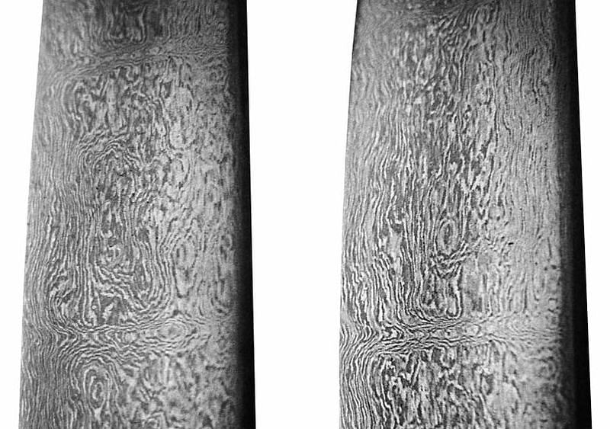
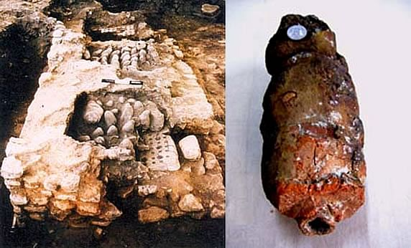
World Famous Indian Metallurgy Work
Rich handicraft industries
During pre-colonial period India was worldwide famous for its handicrafts, cotton textile like muslin and the finest quality was malmal shahi which had its origin in Bengal, silk textile and other stone work industries.
Table:3. Centres of Textile Industry in India
Textile centres
Dacca and Murshidabad in Bengal
Patna in Bihar
Surat and Ahmedabad in Gujarat
Jaunpur, Varanasi, Lucknow and Agra in U.P.
Multan and Lahore in the Punjab
Masulipatnam and Visakhapatnam in Andhra
Bangalore in mysore and Coimbatore and Madurai in Madras
India was the first to smelt zinc on the basis of ancient alchemy during 12th Century AD. One of the great examples of finest craftsmanship in ancient India was manufacturing of Wootz steel by Tamils of Chera Dynasty which was used to make famous Damascus swords of yore (Pal, 2016).
Fig.2. Wootz steel
Fig.3. Smelt zinc

Slide 7
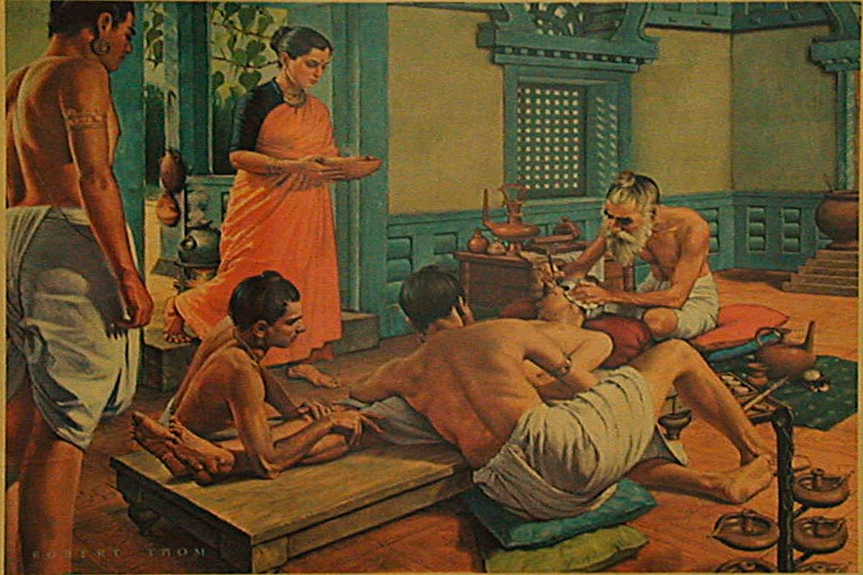
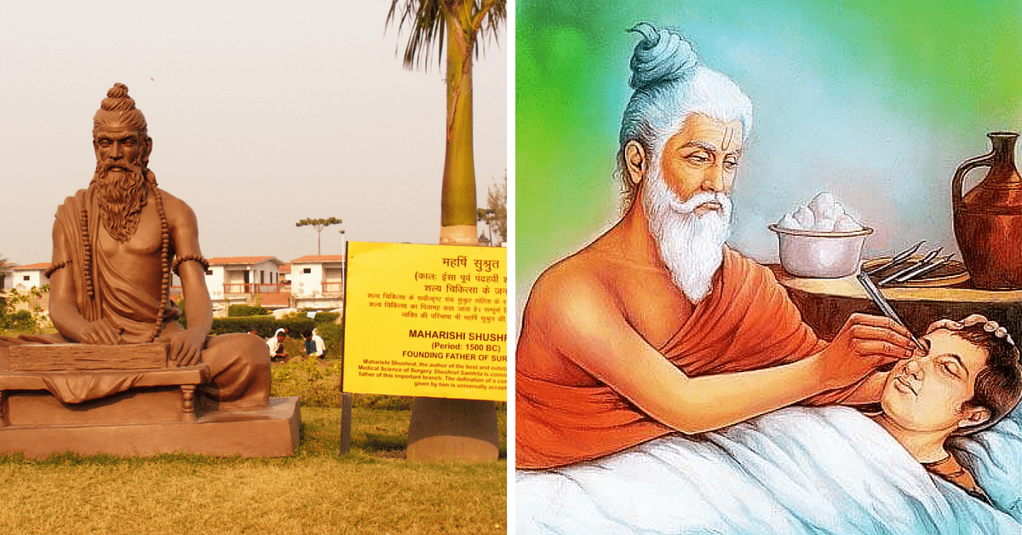
Traditional Health Care System In Ancient India
Fig. 4. Plastic surgery and Cataract Surgery

Slide 8
COLONIAL PERIOD
The British East India Company got a legal charter for trade from the British crown in 1600, and shortly thereafter this trading company started conquering India.
The conquests began in 1757 with the defeat of the Nawab of Bengal by Robert Clive.
The East India Company ruled India for a century i.e., from the decisive Battle of Plassey in 1757 to 1857 when India fought a war of Independence.
The British defeated the Indians in this war and in 1858 Queen Victoria assumed the responsibility of direct rule over India. The rule of East India Company ended and the British Parliament directly became responsible for the governance of India and this continued till 1947.
Science was one of the major factors that helped the British to rule over India and used as an imperialistic tools for utilizing Indian resources for commercial development of Europeans.

Slide 9
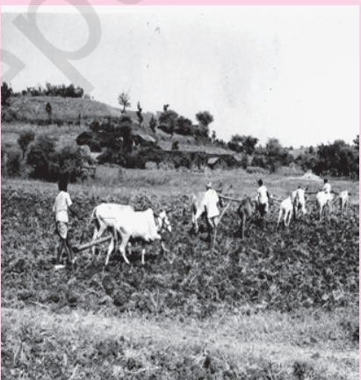
Agriculture Sector
Land settlement system
Introduction of Zamindari system in 1793 by Lord Cornwallis in Bengal, Bihar, Orissa, North Madras.
Implementation of Ryotwari system in 1820 in Madras.
Farmers shifted their cultivation from food crops to cash crops, that was one of the major cause of the famine of 1866 in Bengal and Orissa in which the best land was cultivating indigo instead of rice.
Deteriorated soil condition, lack of drainage facility and lack of financial resources also led destruction of agriculture .
The revenue collections went up, declined food grain prices and depressed rural economy.
Fig.5.
India’s agricultural stagnation under the British colonial rule

Slide 10
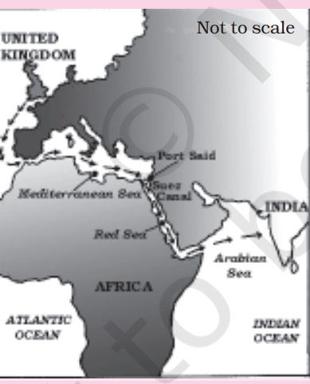
Trade
Britain maintained a monopoly control over India’s exports and imports.
Opening of Suez-canal in 1869 further intensified British control over India’s foreign trade.
The generation of a large export surplus came at a huge cost to the country’s economy which led to the drain of Indian wealth.
Industrial Sector
Policy of systematic de-industrialization with two objectives
To reduce India to the status of a mere exporter of important raw materials for the upcoming modern industries in Britain.
To turn India into a sprawling market for the finished products.
Decline of the indigenous handicraft industries created massive unemployment.
Reduced export market of textile caused 1.5 percent loss of national income.
It was reported that in 1880, Indian customs revenues were only 2.2 percent of the trade turnover, which is lowest among countries.
Increased imports of cheap manufactured goods from Britain.
Fig.6. Suez Canal- Used as a highway for trade between India and Britain

Slide 11
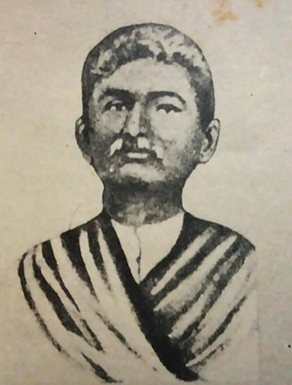
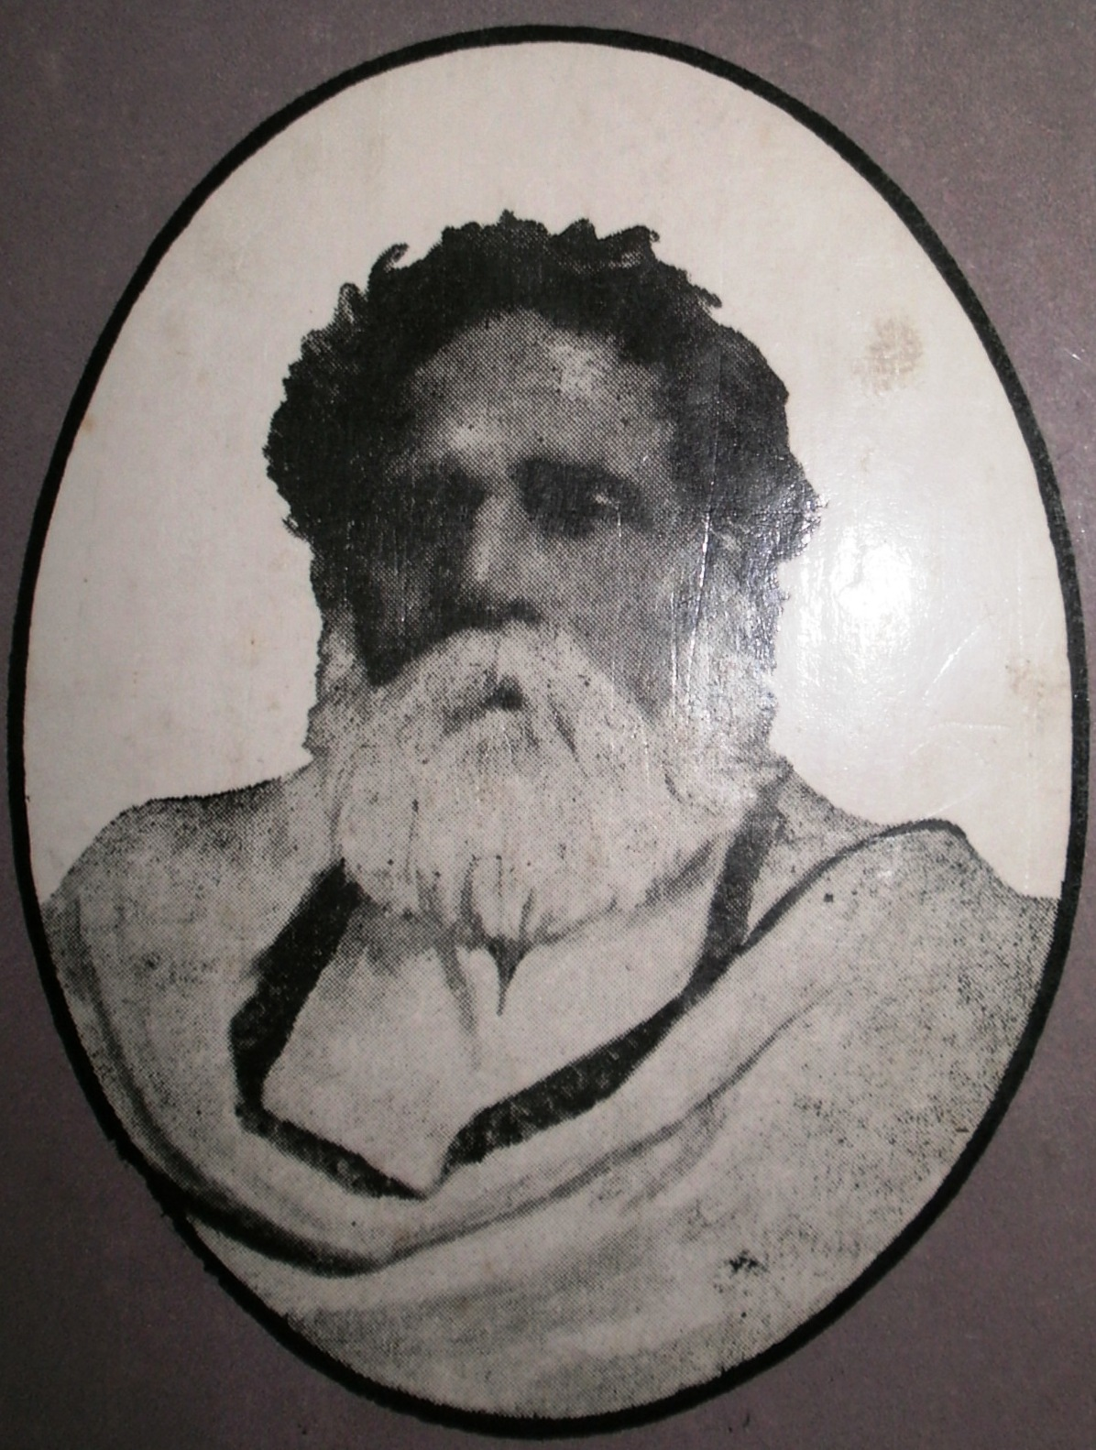
SWADESHI MOVEMENT : The vision of economic independence during colonial period
Proto swadeshi(1820-1857)
The idea to revive traditional crafts and use of indigenous goods was induced during 1820 -1857.
Promotion of use of indigenous products by Gopal Hari Deshmukh in 1849.
Early swadeshi(1857-1890)
The idea became an action during 1857 -1890 in Bengal.
“Hindu Mela” in 1867 to popularise Indian products.
Establishment of National Paper, National Store, National Gymnasium, National School by Nabagopal Mitra and Rajnarain Bose
Emergent political phase( 1890-1903)
Effects of foreign imports on indigenous products.
Boycott of foreign goods
In 1896 swadeshi became a national cause.
Fig.7. Nabagopal Mitra
Fig.8. Rajnarain Bose

Slide 12
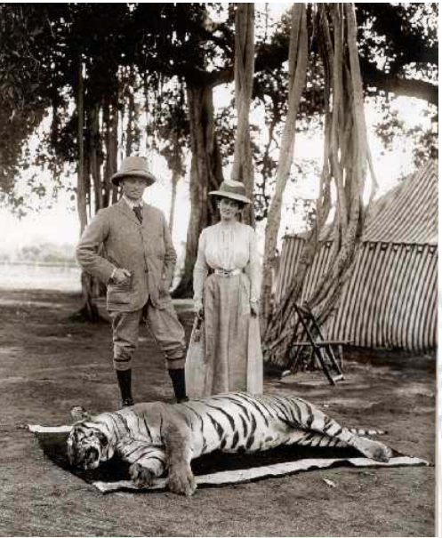
Partition of Bengal
Lord Curzon in 1903 stated the transfer of Chittagong Division, Dhaka, Mymensingh district and hill tracts of Tripura to Assam and Chota Nagpur to the Central Provinces, in exchange Bengal received Sambalpur, Ganjam, Visakhapatnam and parts of Madhya Pradesh.
This anti-partition agitation in the form of the spirit of “Swadeshi.”
Press campaigns were conducted by leaders like Surendranath Banerjee, Motilal Ghosh, Kali Prasad, Prithwish Chandra Roy.
Several swadeshi movement across India like Vande Mataram movement in Andhra Pradesh, then Satyagraha movement laid by Mahatma Gandhi in 1915, and non-cooperation movement.
Involvement of leaders like Bala Gangadhar Tilak, Bipin Chandra Pal, Lala Lajapat Rai, Aurobindo Ghosh, Vo Chidambaram Pillai, Babu Genu
Anti-British force against colonial government.
Fig.9. Lord Curzon

Slide 13
Rise of Swadeshi
The idea behind Swadeshi was to build India self-reliant.
Boycott British goods (Manchester cloth, Liverpool salt).
Leaders like Naoroji, R. C. Dutt and Gokhale drew connections between India’s forced dependence on British manufactures and its poverty.
Economic self -reliance only solution for improving the socio-economic status of the people.
Establishment of national schools, colleges and science research institutes.
Hindrance of swadeshi movement by British owned chemical and pharmaceutical industries.
This is the time when Indian visionaries, scientists and social leaders felt the urge to establish science-based swadeshi small scale pharma and chemical industries in India.
Science based swadeshi industries started a new revolution in colonial India and helped in overcoming the bottleneck of self-reliance in the field of medicine and chemicals.
Formation of various indigenous science based industries not only played a big role in the freedom movement but also made a significant contribution to the Indian economy.

Slide 14
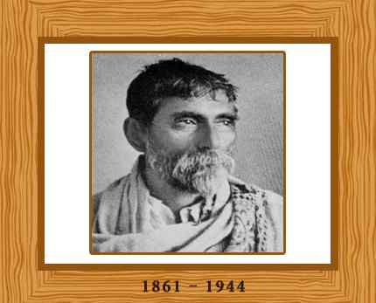
Bengal Chemical and Pharmaceutical Works Ltd.
Acharya Prafulla Chandra Ray was actively involved in educational reforms, industrial development, employment generation and poverty alleviation.
Born on 2 August, 1861 in Khulna District of Bengal.
Earned his Bachelor degree in sciences in 1885 and D. Sc in 1887 from Britain.
In 1888 appointed at the Presidency College Calcutta.
He realized that ‘science’ is the instrument for national reconstruction and envisioned a glorious India through an indigenously developed science and making India Industrially sufficient, especially in the field of pharmaceuticals and chemicals.
Build research foundations in chemistry by his publication of mercurous nitrite.
Known as “Father of Nitrites”.
Released the first Indian Journal named Journal of the Indian Chemical Society.
He wrote the book “ History of Hindu Chemistry”.
Fig.10.
Acharya Prafulla Chandra Ray

Slide 15
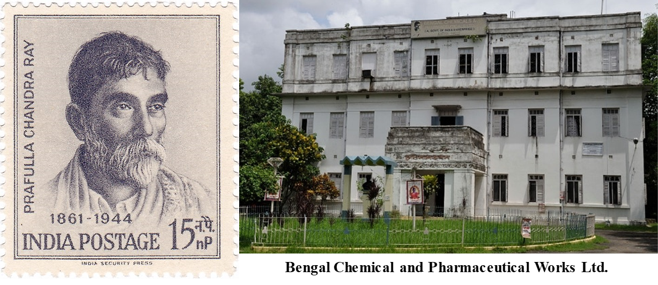
Man behind the first swadeshi chemical industry.
Created a small lab by own savings with a capital of Rs 700.
Started experimenting with indigenous medicine.
Led to the foundation of “Bengal Chemical Works” in 1892.
His vision and dedication inspired many doctors like Dr. Amulya Charan Basu, leaders like Chandra Bhusan Bhaduri, Radha Gobinda Kar, Kulbhusan Bhaduri, and Suresh Prasad Chittaranjan Das and Subhas Chandra Bose.
Bengal Chemical and Pharmaceutical Works Ltd. (BCPL) in 1901.
Laid the foundation of several other industries including the Calcutta Pottery Works, Bengal Enamel Works, National Tannery Works, Bengal Steam Navigation Company.
These efforts created a huge number of employment and raised the socio-economic status of Indians during the colonial period.
Fig.11. Bengal Chemical and Pharmaceutical Works Ltd. (BCPL)

Slide 16
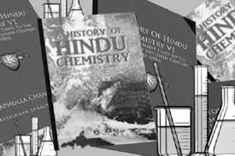
Replaced many British products with diverse product range and became a leading chemical and pharmaceutical company of our country.
Assisted revolutionaries in preparing explosives.
The British administration recorded his name as a ‘revolutionary in the garb of a scientist.
Today’s Status
Bengal Chemicals is a trusted name in the field of Home Products, Pharmaceuticals and Chemicals with a rich heritage for more than 100 years giving annual turnover of Rs 50-100 crores.

Slide 17
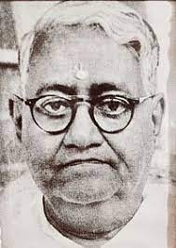
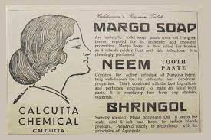
Calcutta Chemical by Khagendra Chandra Das
Born in environment heavily influenced by swadeshi sentiments.
Completed his education from Kolkata Presidency College.
Became part of swadeshi movement with political leaders like Surendranath Banerjee, Bal Gangadhar Tilak.
Completed his graduation in chemistry in 1910 from Stanford University.
Became the forerunners of the original “Make in India '' movement and associated with the Indian Independence league in California Branch.
Studied pharmaceutical and chemical industry business from Japan University.
Explored the chemical properties of neem and established swadeshi venture Calcutta chemical company in 1916 (Barua, 2020) with the help of his two friends R N Sen and B N Maitra.
In 1920 produced neem based soap marketed under name Margo.
Great supporter to the ideals of entrepreneurship.
Provided seed capital for various ventures pre-independence and post independence till he died in 1960.
Fig. 12.
Khagendra Chandra Das founder of Calcutta Chemical Margo soap

Slide 18
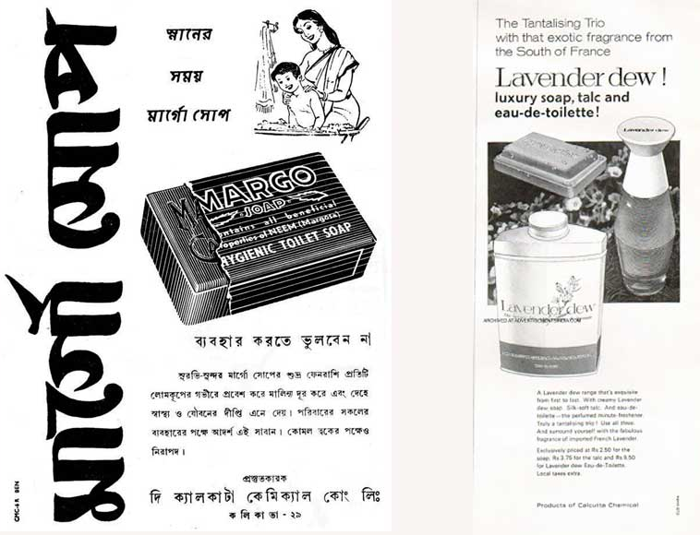
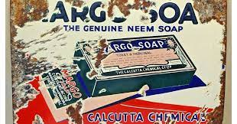
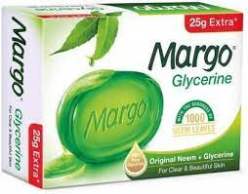
Today’s Company Status and Product Range
Remarkably contributed in creating swadeshi science industries during colonial times.
Generated large number of employment and contributed in Indian economy.
In 1988 attained top five position among other brands with a market share of 8.5% (Sengupta, 2005).
Created a talcum powder marketed under the name Lavender Dew.
Leading fast -moving consumer goods product brand in the international market in late 20 century (Neem toothpaste and Margo soap).
In 2001 the brand had a worth of Rs 75 crore and belonged to Henkel-SPIC.
In 2003 company diversified his product considering different age groups which had a market share of 2% of the premium soaps segment in India.
Fig.13.
Margo soap and Lavender Dew
Year of Establishment | Brand Name | Market share/ Worth
2007-2008 | 'Ruby' liquid blue and 'More Light' | 80% market share
2011 (Jyothy Labs Ltd.) | Exo | Rs 80 crore.
 | Maxo mosquito coil | Rs 1000 crore
 | Mosquito coil | 23 % market share
2021-2022 ( Total Turn over) |  | Rs 1,800 crore
Past & Present

Slide 19
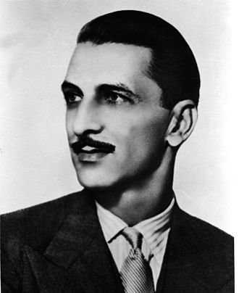
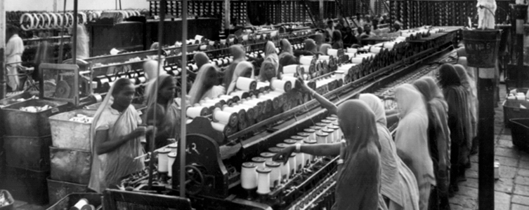
TATA Group by JRD TATA
Jamsetji Tata was a strong supporter of Swadeshi.
Started a trading company in 1868 with a capital of Rs 21,000, today’s well known Tata Group.
In 1869 purchased an oil mill, transformed into cotton mill (Alexander mill).
In 1874 established the Central India Spinning, Weaving, and Manufacturing Company in Nagpur.
Established new cotton mill named “Empress Mill” in 1877.
Marked initiation of Swadeshi movement with Dharamsi Mills in 1886.
Utilized private funds from the bank and made a trust for his family which he offered as a guarantee to the bank, then, he purchased modernized machinery.
His Swadeshi’s yarn became competent with Lancashire’s cotton mills yarn
Tata had a vision to make India as a primary manufacturer of cotton cloth, India eventually became an exporter country.
Fig.14.
Jehangir Ratanji Dadabhoy Tata
Fig.15. Cotton Mill

Slide 20
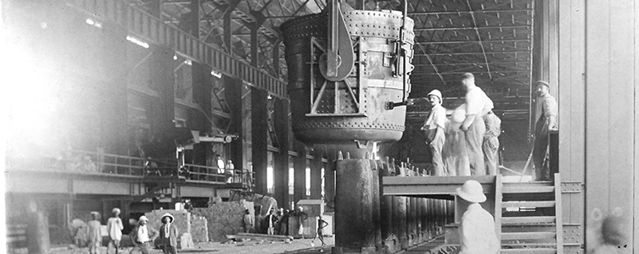
His vision of swadeshi motivate him to build the world's best steel plant in India.
Dorab and cousin RD Tata established Tata iron and steel company in remote areas of Sakchi in the year 1907.
Three hydroelectric entities, Tata Hydro-Electric Power Supply Company (in 1910), the Andhra Valley Power Supply Company (in 1916) and the Tata Power Company (in 1919), were established with an installed generation capacity of over 8000MW.
Supported hugely during the first world war (1914).
TELCO (Tata Engineering & Locomotion Company) built in Jamshedpur in 1945.
Provided financial assistance to Homi . J. Bhabha and Established Tata Institute of Fundamental Research.
Generated large number of employment to Indians and contributed in Indian economy.
Contributed in making India an Industry sufficient country.
Todays Status: Represents a large global enterprise
With many companies like Tata Consultancy Services, Tata Motors Tata Steel, Tata Chemicals, Tata Consumer Products, Titan, Tata Capital, Tata Power, Indian Hotels, Tata Communications, Tata Digital, and Tata Electronics
Operating in more than 100 countries employing over 800,000 people. In the year 2020-21, the revenue of Tata companies was 103 billion dollars (INR 7.7 trillion).
Fig 16.
Tata Iron & Steel Plant
Jamshedpur

Slide 21
CONCLUSION
The thought of “Self-reliance” in the field of science during British rule encouraged Indian scientists, activists and patriots to establish our own scientific institutions, laboratories and industries which helped in overcoming the bottleneck of self-reliance.
Genesis of today’s ‘Make in India’ and ‘Vocal for Local’ movement.
Will revive manufacturing sector, generate employment and growth of Indian economy.
India is expecting to raise the manufacturing sector by 12 to 14% by the end of 2022 and to generate 100 million jobs, increase manufacturing share of GDP by 25% and will build up the global competition of the Indian manufacturing sector.
When the first wave of Covid came in India in 2020, there was a lack of resources to tackle the pandemic but within one year, India has become self-reliant in terms of ventilators, medicines, PPE kits, N-95 masks, testing labs for coronavirus, ICU beds, Corona-dedicated hospitals, medical oxygen etc.
From just 900 Metric Tonnes per day before January 2020, production of medical oxygen has now been increased to more than 9,000 MT per day,
More than 20,000 ICU beds are being added across the country out of which 20 per cent will be pediatric ICU beds.

Slide 22
REFERENCES
Appadorai, A. (1974). Documents on Political Thought in Modern India: Vol. 2. Oxford University Press.
Bayly, C A. (1986). The Origins of Swadeshi (Home Industry): Cloth and Indian Society, 1700–1930. Edited by Arjun Appadurai. Cambridge University Press.
Banerjee, S. (2011). Acharya Prafulla Chandra Ray: an epitome of scientiﬁc attitude and human values Breakthrough, 15 (1), 12-24.
Barua, A. (2020). Proudly Swadeshi, This Neem Soap Was A Pioneer of Indian Manufacturing in 1920. The better academy.(https://www.thebetterindia.com/234389/swadeshi-movement-freedom-struggle-margo-soap-history-make-in-great-india-manufacturing-ana79/)
Baul, D. (2022). The Swadeshi Movement. Center for Policy Research, Institute of Lifelong Learning, University of Delhi New Delhi.
Chakraborty, S.(2012). Preserving P C Ray for Posterity from the Perspective of the Library & Information Science Profession. Calcutta University Journal of information Studies, 14 (i), 1-9.
Chandra, Bipan. 2016. The Rise and Growth of Economic Nationalism. Har-Anand Publications Pvt Ltd.
Dutt, R.C. (1901).op. cit., p. xxv.
Indian Economy on the Eve of Independence., NCERT, Book for Class 11 Economics Chapter 1.

Slide 23



