Slide 1



International Conference on Contribution of Acharya Prafulla Chandra Ray as Chemist and Freedom Fighter
2nd Aug– 03rd August, 2022
Sub-theme : Acharya’s Contribution to India’s Independence struggle
Title
Acharya PC Ray: who used Science as a weapon to make India Independent
[Registration No: 193]
Presented By
Dr. Himanki Dabral ^{1,2}, Mr. Ramesh Kumar Singh² & Dr. Anu Singh^{2,3}
¹Associate Professor, Department of Genetics & Plant Breeding, School of Agricultural Sciences, Shri Guru Ram Rai University, Dehradun Uttarakhand, India
²Samvetan Society for Social & Scientific Research , Dehradun, Uttarakhand, India
³School of Biotechnology, Jawahar Lal Nehru University, New Delhi, India
Corresponding Address : Samvet Bharat Under the aegis of Samvetan Society for Social & Scientific Research, Dehradun(Uttarakhand)

Slide 2
CONTENTS
Introduction
PC Ray Early Years
As Adolescent
As Teenager
The Young PC Ray
As a Teacher and Research Scientist
Education and Social Reformer
As Entrepreneur
His vision towards modern India
Conclusion
References

Slide 3
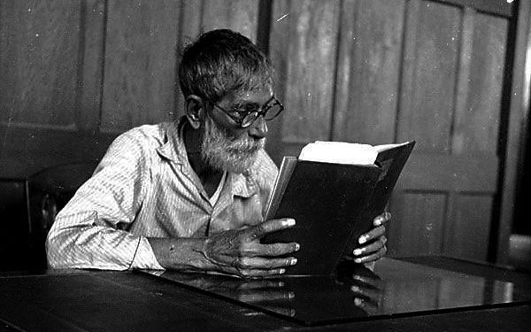
INTRODUCTION & PURPOSE OF THE WORK
Acharya Prafulla Chandra Ray – A sage-scientist and a patriot who led India towards modern chemistry.
Father of Chemical Sciences “ Master of Nitrites.”
An educationist, historian and entrepreneur.
Man behind the first swadeshi pharmaceutical and chemical industry “Bengal Chemical Works” in 1892.
Fig.1. Acharya Prafulla Chandra Ray

Slide 4
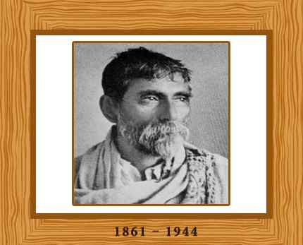
His – Early Years
As an Adolescent: Upbringing in a patriotic environment
Born on 2nd August, 1861, in the village Raruli of the Khulna District of Bengal.
His father Shri Harish Chandra was a landlord associated with the cultural and intellectual leaders of those days in Bengal.
Prafulla’s mother, Smt. Bhuban Mohini Devi was also an accomplished lady of enlightened views.
Such an education-loving and cultured family atmosphere influenced Prafulla Chandra’s character greatly in its formative years
Prafulla Chandra started his education in the school founded by his father.
Shifted to Hare School in 1870 in Calcutta for Higher Education.
In 1874 affected with a virulent type of dysentery and forced return to his village.
Fig.2
Acharya Prafulla Chandra Ray

Slide 5
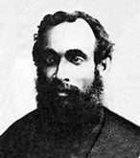
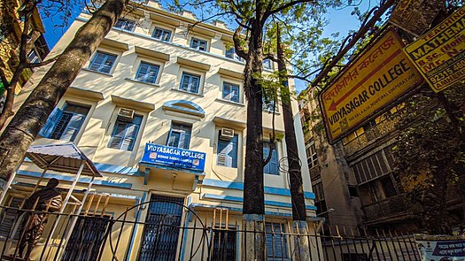
As a Teenager: Inculcation of Scientific Temperament
Fig.3. Surendra Nath Banerjee
In 1879 joined Metropolitan College (Vidyasagar College) National institute.
The patriot Surendra Nath Banerjee, instilled in him a sense of nationalism.
Excited by the exposure at the Presidency College and built a small laboratory in his house.
Modern science and technology key to country freedom and progress.
Fig.4 Vidyasagar College

Slide 6
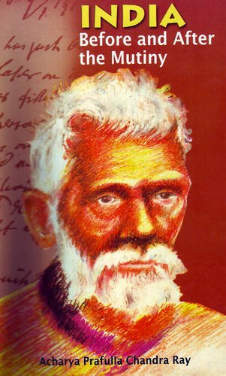
The Young P C Ray: Rising of a Patriot
Earned his Bachelor degree in sciences in 1885 and D. Sc in 1887 from Edinburgh University Britain.
Participated in essay competition on topic “India before and after Mutiny” got published in 1886 in Scottish newspaper appeal Indian Students to take step to free India from colonial bondage.
Highlighted lamentable condition of India due to England, Indian government is a tax squeezing machinery.
Additional burden imposed upon the Indian taxpayer in the form of an increased duty on salt.
Fig.5 Wriiten by PC Ray

Slide 7
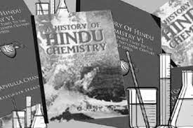
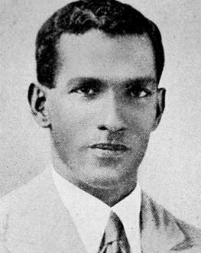
As a Teacher and Research Scientist: Vision for Development and Freedom of the Nation
In 1888 appointed as teacher at Presidency College, Calcutta in a salary of Rs. 250/ month.
He realized that ‘science’ is the instrument for national reconstruction and envisioned a glorious India through an indigenously developed science and making India Industrially sufficient, especially in the field of pharmaceuticals and chemicals.
Build first research laboratory at Presidency College.
His patriotic zeal undertake the most painstaking work of collecting materials on the history of ancient Indian chemistry “ History of Hindu Chemistry.”
First Indian scientist to be nominated for FRS in 1912.
Non election to FRS supporter of Gandhi Non-cooperation movement.
CV Raman was elected FRS in 1924 before the discovery of Raman effect, which brought him the Nobel Prize in 1930.
Fig.6 A Young PC Ray

Slide 8
The Research Scientist: Presenting India on Global Platform
Known as “Father of Nitrites” build research foundations in chemistry by his publication of mercurous nitrite.
Area of research : Isomorphous of Univalent mercury with silver decomposition of hyponitrous acid, Sublimation of Ammonium Nitrite in a Vacuum and Determination of the Vapour Density of Ammonium Nitrite.
Published 158 research papers (about 60%) in scientific journals like Nature and the Journal of the Royal Society.
Published 109 research papers in international journals like Proceedings of Royal Society of Edinburgh, Proceedings of Chemical Society(London), Zeitschrift fur anorganische allge meine(Germany), Annalen der Chemie (Germany), Journal of Indian Chemical Society, Themical News and Nature.

Slide 9
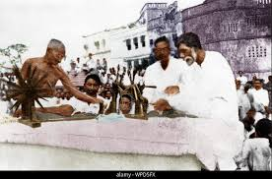
Education and Social Reformer: Creating Scientific Platforms for Indian Students
Took initiative to create the Indian Chemical Society.
Published the first research journal in India, the Journal of the Indian Chemical Society.
In 1912 as a representative of the university of Calcutta demanded proper recognition of the degree of Indian University
In 1919 he participated with C.R. Das to protest Rowlett Act “ Science can wait but Swaraj cannot”.
Associated with National Council of Education, Bengal.
Supported the cause of setting National schools and colleges(1921-1926).
Opposed nationalism on the basis of religion.
Fig.7 P.C. Ray admirer of Mahatma Gandhi

Slide 10
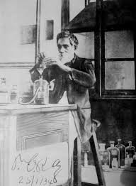
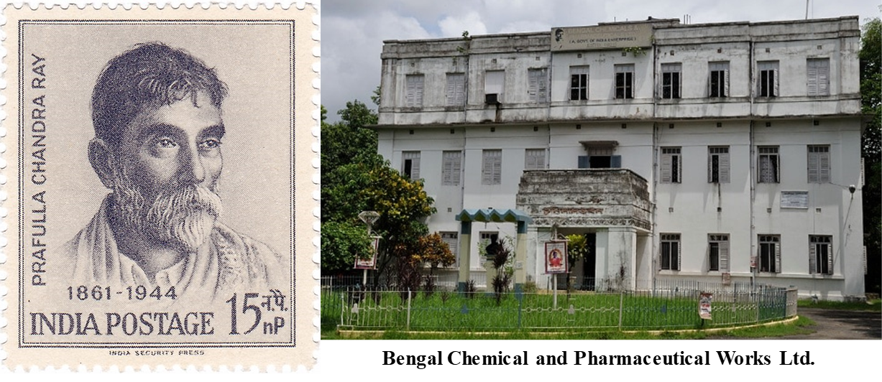
As Entrepreneur: Initiatives for Self-Reliant India Before & After Independence
Created a small lab by own savings with a capital of Rs 700.
Started experimenting with indigenous medicine.
Led to the foundation of first Indian Pharmaceutical Chemical industry “Bengal Chemical Works” in 1892 which became a limited company in 1902 renamed as Bengal Chemical and Pharmaceutical Works Ltd (BCPWL).
Gradually laid the foundation of several other industries including the Calcutta Pottery Works, Bengal Enamel Works, National Tannery Works, Bengal Steam Navigation Company.
These efforts created a huge number of employment and raised the socio-economic status of Indians during the colonial period.
Replaced many British products with diverse product range and became a leading chemical and pharmaceutical company of our country.
Fig.8
P.C. Ray working in the BCPW laboratory
One of the main reason for the failure of swadeshi movement in 1905 was dependency on British chemical and pharmaceutical industries in India.
PC Ray’s efforts during colonial period was the first step in making India self-reliant in the field of chemical and pharmaceutical industry.

Slide 11
Revolutionary in the garb of a scientist.
Assisted revolutionaries in preparing explosives. For the cause of Independence, Ray helped those involved in violent methods to make bombs and supplied them with acid,”
This led the administration to record his name as a “revolutionary in the garb of a scientist”.

Slide 12
His vision towards modern India
Today’s Status
Bengal Chemicals is a trusted name in the field of Home Products, Pharmaceuticals and Chemicals with a rich heritage for more than 100 years giving annual turnover of Rs 50-100 crores.
When the first wave of Covid came in India in 2020, there was a lack of resources to tackle the pandemic but within one year, India has become self-reliant in terms of ventilators, medicines, PPE kits, N-95 masks, testing labs for coronavirus, ICU beds, Corona-dedicated hospitals, medical oxygen etc.
Production of a chloroquine similar drug as hydroxychloroquine used in corona treatment BCPL is back in the spotlight.
From just 900 Metric Tones per day before January 2020, production of medical oxygen has now been increased to more than 9,000 MT per day,
More than 20,000 ICU beds are being added across the country out of which 20 per cent will be pediatric ICU beds.
Table.1 Renowned students of PC Ray
Researchers/Founders / Directors | Established Institutions
Jnan Chandra Ghosh C V Raman | IISc Bangalore, IIT Kharagpur Nobel Laureate
Panchanan Niyogi | Raja Manindra Chandra
Nil Ratan Dhar | Allahabad University

Slide 13
CONCLUSION
The thought of “Self-reliance” in the field of science during British rule encouraged P.C. Ray to establish scientific institutions, laboratories and industries which helped in overcoming the bottleneck of self-reliance.
Genesis of today’s ‘Make in India’ and ‘Vocal for Local’ movement.
Will revive manufacturing sector, generate employment and growth of Indian economy.
India is expecting to raise the manufacturing sector by 12 to 14% by the end of 2022 and to generate 100 million jobs, increase manufacturing share of GDP by 25% and will build up the global competition of the Indian manufacturing sector.
At that time PC Ray utilized science as a weapon to free India from colonial bondage , but this is also a high time that we should realize the adoption of only science technology will going to help us in building our nation self reliant.

Slide 14
REFERENCES
Appadorai, A. (1974). Documents on Political Thought in Modern India: Vol. 2. Oxford University Press.
Bayly, C A. (1986). The Origins of Swadeshi (Home Industry): Cloth and Indian Society, 1700–1930. Edited by Arjun Appadurai. Cambridge University Press.
Banerjee, S. (2011). Acharya Prafulla Chandra Ray: an epitome of scientiﬁc attitude and human values Breakthrough, 15 (1), 12-24.
Baul, D. (2022). The Swadeshi Movement. Center for Policy Research, Institute of Lifelong Learning, University of Delhi New Delhi.
Chakraborty, S.(2012). Preserving P C Ray for Posterity from the Perspective of the Library & Information Science Profession. Calcutta University Journal of information Studies, 14 (i), 1-9.

Slide 15




